Slide 1

DATA ENGINEERING 1
TRADEOFFS OF DATA ARCHITECTURES
Laszlo Sallo
OCTOBER 2021

Slide 2
DATA WAREHOUSE IMPLEMENTATION
FAILURE RATE
80%

Slide 3
REASONS
REASONS
Complex
Easy get lost
Lots of documentation
Hard to maintain
Data quality / Junks

Slide 4
REASONS
A full corporate DW implementation
takes years
High cost
Lost commitment
Change in business

Slide 5
REASONS
Long term design is not easy
World is changing quickly
DW is inflexible on change

Slide 6
REASONS
REASONS
Requires the whole organization
Not just IT
Organizational silos
Identify the key users
Unified data dictionary

Slide 7

DATA SYSTEM REVOLUTION IN LATE 2000’S

Slide 8
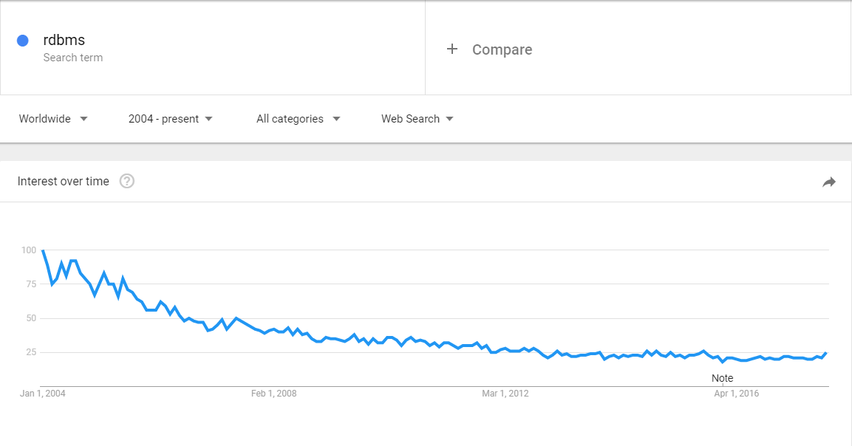
RDBMS

Slide 9
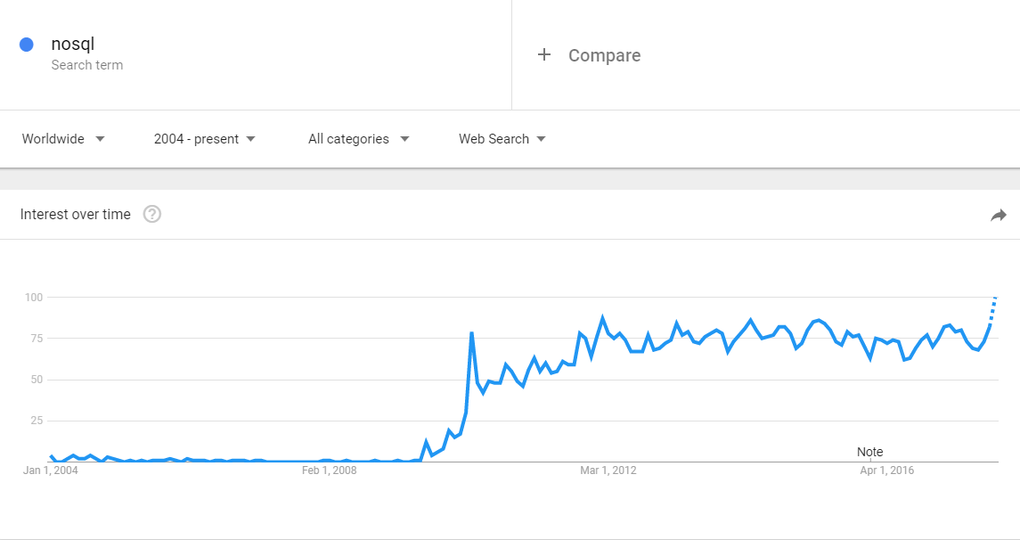
NOSQL

Slide 10
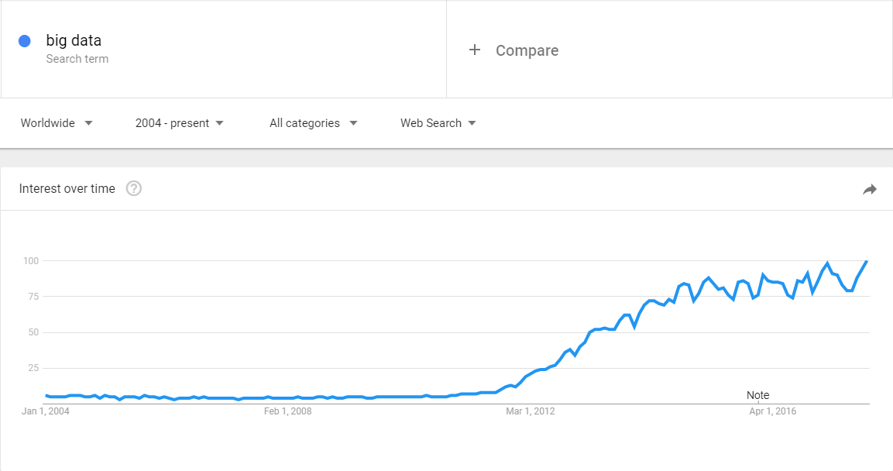
BIG DATA

Slide 11









DATA LANDSCAPE BEFORE 2010

Slide 12
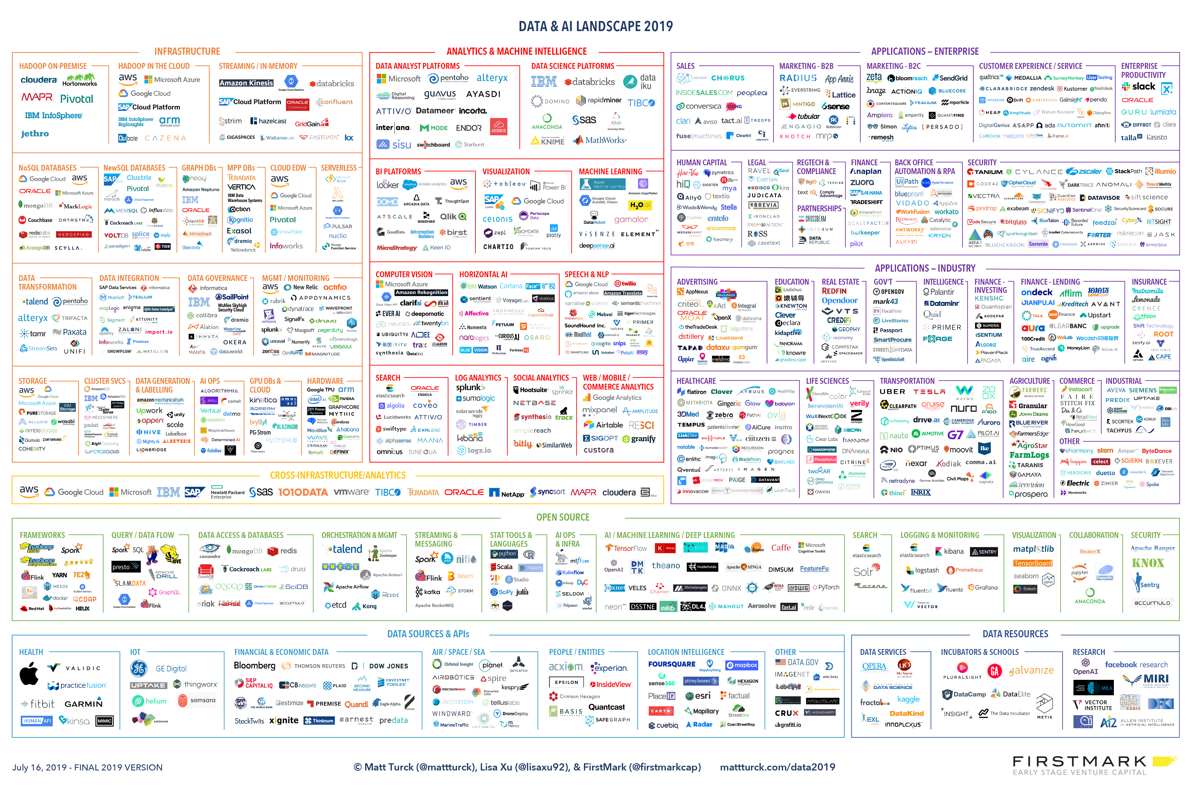

Slide 13
WHAT HAPPENED?
WHAT HAPPENED TO THE WORLD
TO GENERATE SUCH A
CHANGE ?

Slide 14

CHALLENGES
SOCIAL MEDIA

Slide 15

CHALLENGES
MOBILITY & IoT

Slide 16

CHALLENGES
DIGITAL TRANSFORMATION

Slide 17
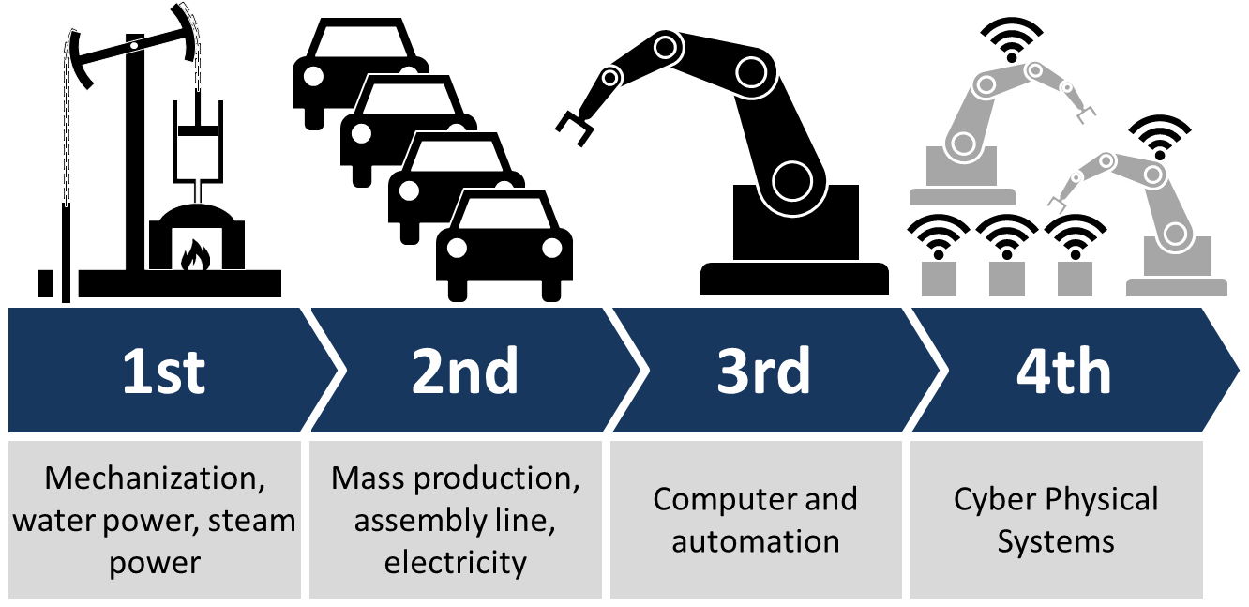
CHALLENGES
INDUSTRY 4.0 or SMART FACTORY

Slide 18

CHALLENGES
STARTUPS

Slide 19
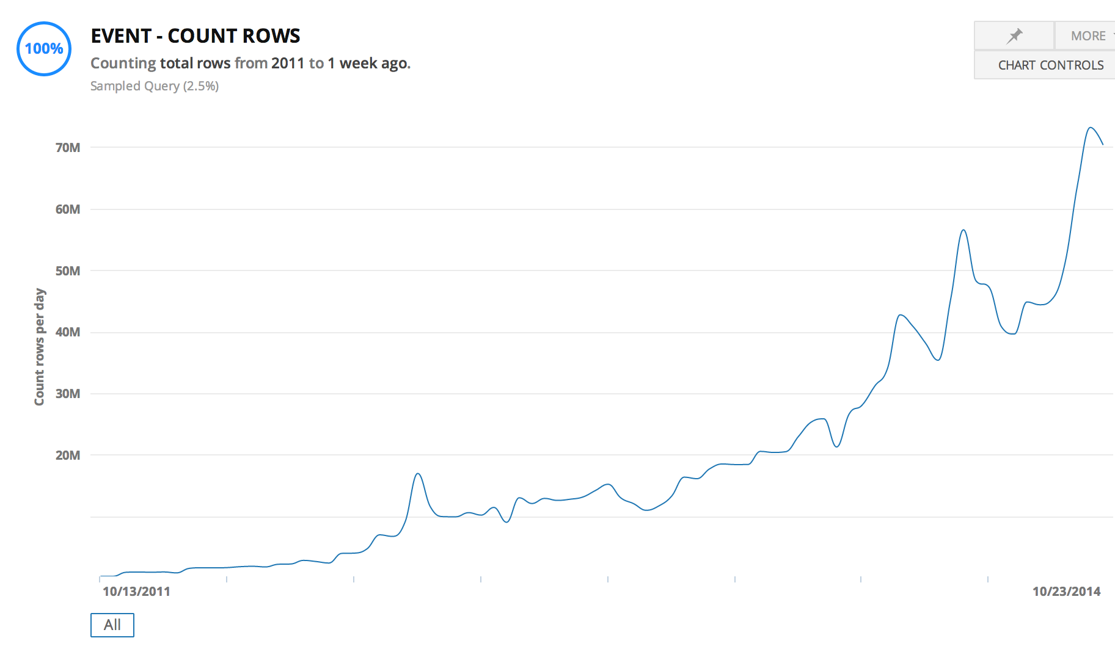

STARTUP DATA SCALE

Slide 20
DEMAND 1
DEMAND FOR EASY SCALE
Cheap scale up and down

Slide 21
DEMAND 2
NEED FOR HIGH AVAILABILITY
We are 24/7 dependent on digital
Notes:
Slow / Bad design
Deployment
Hardware / Network failure
Security threats
Bug in a software
3rd party failure

Slide 22
DEMAND 3
HANDLE LARGER DATA
Cheap storage
Analyze large datasets

Slide 23
DEMAND 4
APPETITE FOR REAL TIME DATA
Real time operations
Real time analytics
Notes:
Automated cars
Real-time bidding (RTB)
Stock exchange
Telemedicine
Blockchain

Slide 24
SUMMARIZED
DEMAND FOR
Real time + Highly available + Large data
In
Economically feasible way
Notes:
Automated cars
Real-time bidding (RTB)
Stock exchange
Telemedicine
Blockchain

Slide 25
COST OF DATA
1 Gigabyte
$2.64 billion in 1965
$0.09 in 2020 (India)

Slide 26



THE KNIGHTS OF CHANGE
OPEN SOURCE SOFTWARE IS SOFTWARE WITH SOURCE CODE THAT ANYONE CAN
INSPECT,
MODIFY,
OR ENHANCE.

Slide 27
THE FIRST IDEA: DISTRIBUTED SYSTEMS

Slide 28


SERVER – CLIENT ARCHITECTURE
CLIENT
CLIENT
CLIENT
SERVER

Slide 29
TERMINOLOGY
THROUGHPUT (LOAD) (hits/second)
LATENCY (RESPONSE TIME) (millisecond)

Slide 30
SCALING
CLIENT
CLIENT
CLIENT
VERTICAL
SCALING
SERVER

Slide 31

DISTRIBUTED SYSTEMS
CLIENT
CLIENT
CLIENT
HORIZONTAL
SCALING
SERVER CLUSTER
NODE 1
NODE 2
NODE 3
NODE 4

Slide 32
HORIZONTAL SCALING - REPLICATION
CLIENT
CLIENT
CLIENT
REPLICATION
SCALE ONLY FOR PERFORMANCE
LOAD BALANCER
SERVER CLUSTER
COMPANY
DATA
COMPANY
DATA
COMPANY
DATA
COMPANY
DATA

Slide 33
HORIZONTAL SCALING - PARTITIONING
CLIENT
CLIENT
CLIENT
PARTITIONING
HAVE TO KNOW WHERE TO GO
UNBALANCED
PROXY
SERVER CLUSTER
COMPANY
EUROPE
DATA
COMPANY
AMERICA
DATA
COMPANY
ASIA
DATA
COMPANY
AFRICA
DATA

Slide 34
HORIZONTAL SCALING - SHARDING
CLIENT
CLIENT
CLIENT
SHARDING
CAN BE SLOW
AGGREGATOR
SERVER CLUSTER
COMPANY
DATA A
COMPANY
DATA B
COMPANY
DATA C
COMPANY
DATA D

Slide 35
BARE METAL SERVER
ISSUES
COSTLY
COMPLICATED
HARD TO SCALE

Slide 36
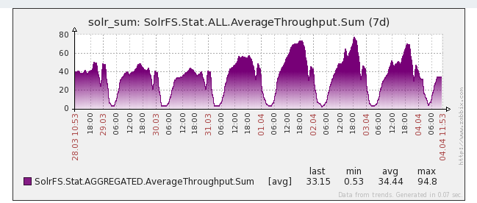
USE CASE – DAY/NIGHT PROBLEM
THROUGHPUT

Slide 37
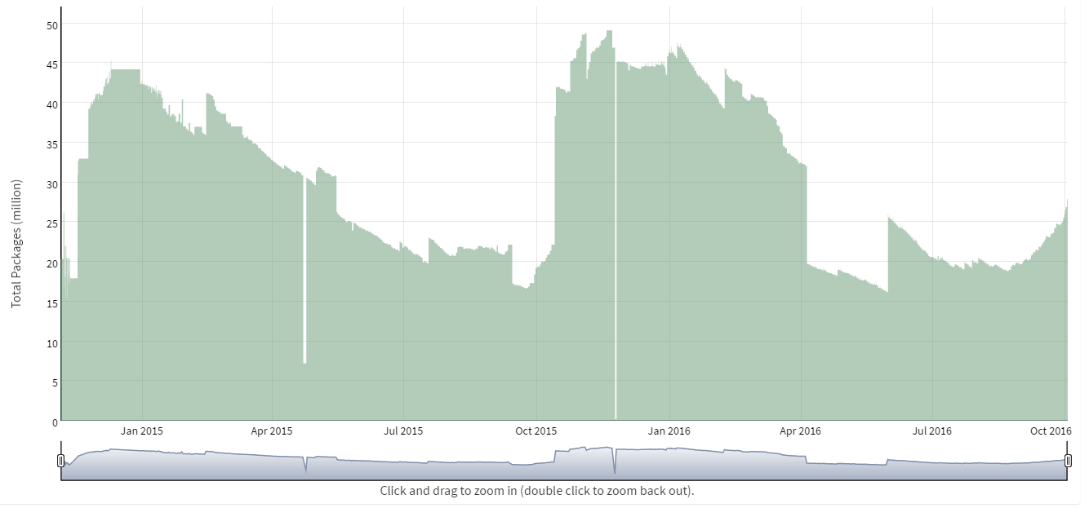
USE CASE – SEASONAL INVENTORY
DATA SIZE

Slide 38
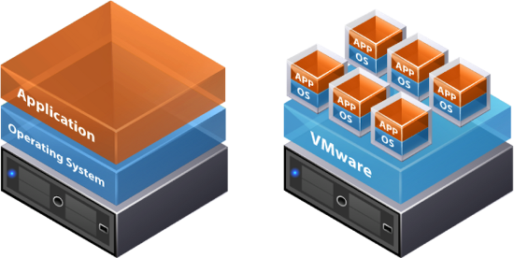
THE NEXT IDEA: VIRTUALIZATION + DATA CENTERS

Slide 39
VIRTUALIZATION
ISSUES
COSTLY
COMPLICATED
HARD TO SCALE
SECURITY: PRIVATE VS PUBLIC

Slide 40

THE NEXT IDEA: CLOUD

Slide 41
USE CASE - AMAZON
…
5% utilized
NODE 1
NODE 2
NODE 3
NODE 4

Slide 42

CLOUD
2006

Slide 43
WHAT IS CLOUD?
A PIECE OF SOFTWARE WHICH OFFERS:
TOOLS TO REMOTELY AND SIMPLY HANDLE
VIRTUAL HARDWARE AND/OR SOFTWARE.

Slide 44
CLOUD
ISSUES
COSTLY
COMPLICATED
HARD TO SCALE
SECURITY
BENEFITS
GEO SAFE
AUTOMATION
ICA (Infrastructure as code)

Slide 45
FINANCIAL CONDUCT AUTHORITY (UK)
We see no fundamental reason why cloud services (including public cloud services) cannot be implemented, with appropriate consideration, in a manner that complies with our rules.
(2016.07.07)
https://www.fca.org.uk/publications/finalised-guidance/fg16-5-guidance-firms-outsourcing-%E2%80%98cloud%E2%80%99-and-other-third-party-it

Slide 46
FURTHER BENEFITS
XAAS
IAAS – Infrastructure as a service
PAAS – Platform as a service
STAAS – Storage as a service
SAAS – Software as a service
DAAS – Database as a services
Serverless

Slide 47



CLOUD PROVIDERS

Slide 48

THE NEXT IDEA: BUILD NEW TOOLS

Slide 49
RDBMS IN A NEW PERSPECTIVE
RDBMS
= DESIGNED FOR OPERATIONS
= DESIGNED TO BE PERFECT IN EVERY SITUATION

Slide 50
CHARACTERISTICS OF RDBMS
Consistency is always guaranteed
Consistency over availability
Fully available or not available at all
…
FOR MORE READ ABOUT: ACID & CAP
Notes:
Consistency: Availability correlates with revenue and consistency generally does not.
Availability: partial availably ?
100% PERFECT
= $$$$$

Slide 51

DO WE REALLY NEED RDBMS PERFECTION?

Slide 52
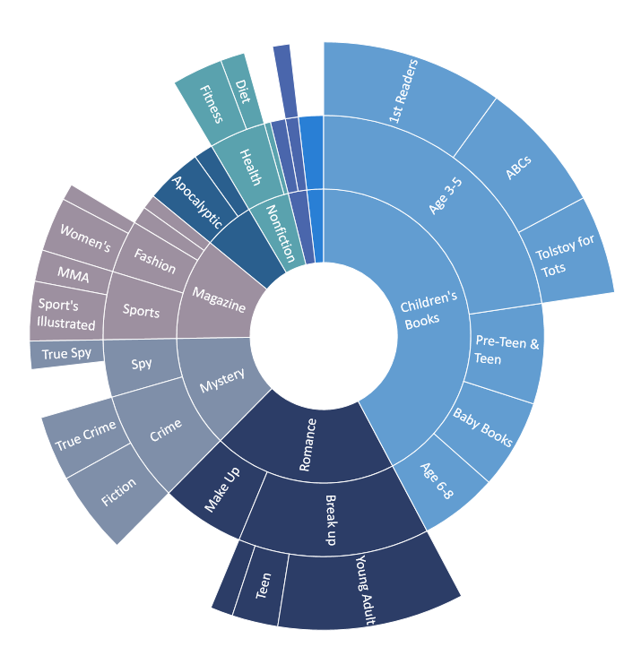
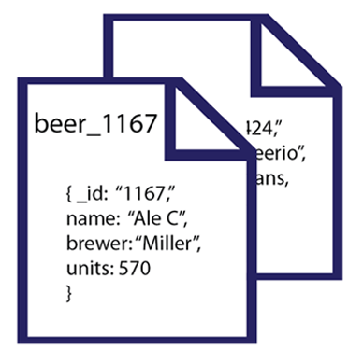
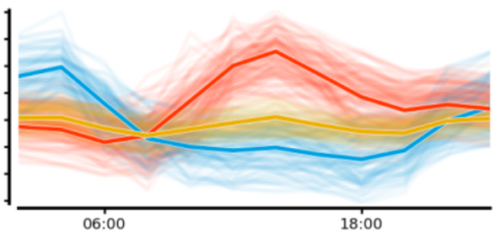
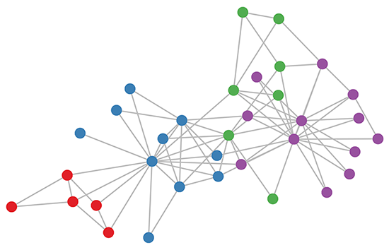
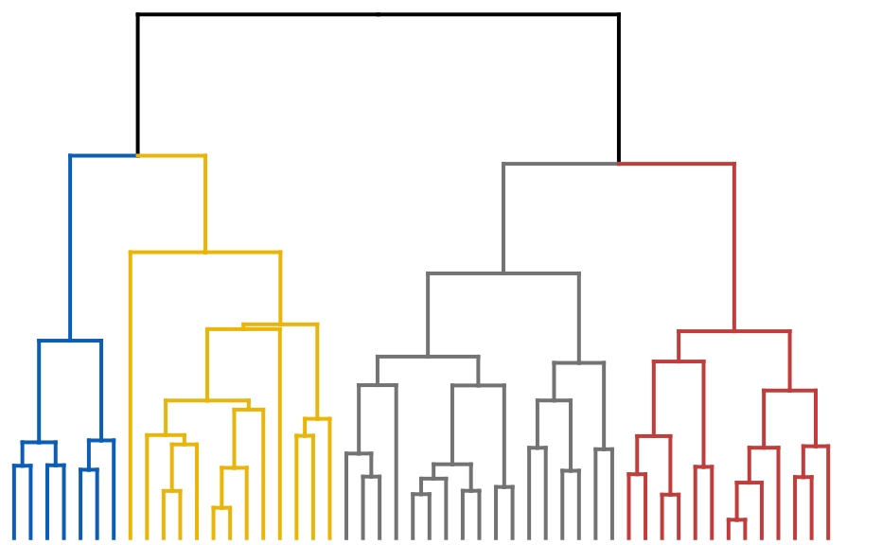
CAN WE GO BEYOND TABULAR DATA?

Slide 53
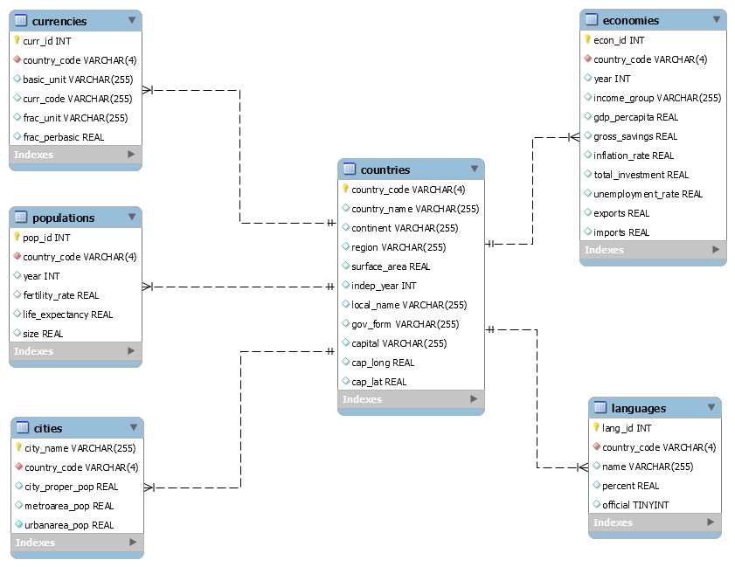
DO WE NEED THOSE RIGID SCHEMAS?

Slide 54
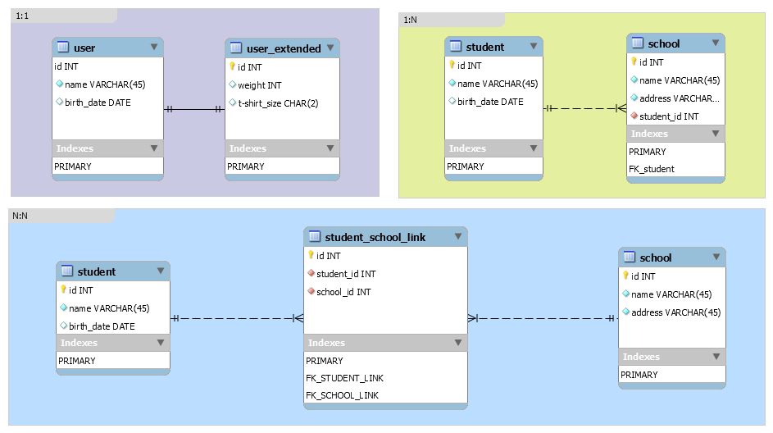
INDEXING
DB
Index

Slide 55


SPECIALIZED
NEW TOOLS
RDBMS

Slide 56
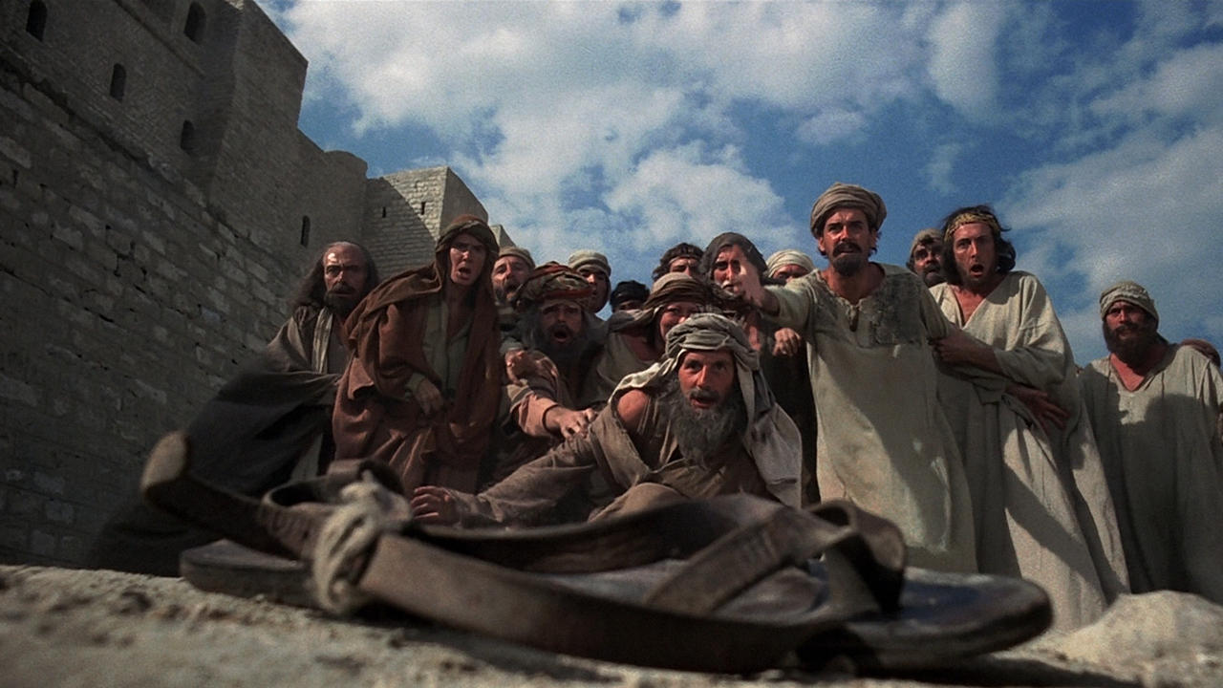
BIG DATA, NOSQL, …

